Slide 1
DialogFlow vs. Lex
A BAH love story

Slide 2

TLDR
Based on enterprise-level data points: available services, user friendliness, and response formats, we as a team have concluded that Google DialogFlow CX is the preferred option for development of the VA's Voicebot.

Slide 3

Documentation
DialogFlow
Clear and concise
Everything has worked as documented
Didn’t have to blackbox to find features
Lex
V2 Documentation is lacking
Missing clear definitions
Properties not fully defined
Had to refer to V1 documentation to find answers

Slide 4
Service Integrations
DialogFlow
Uses HTTP “WebHook” calls
Underlying service could be hosted anywhere; additional setup required
Deployments of Google Cloud Functions very slow
Means HTTP endpoints might be exposed and need to be secured
Deployment strategy using Terraform
Lex
Directly calls Amazon’s Lambda
Underlying service must be hosted within Amazon
Deployments of Amazon Lambda’s very quick
Means Lambdas are internal and require fewer security restrictions
Deployment strategy using Terraform

Slide 5
Response Formats
DialogFlow
All fields well documented in response object
Makes working with variables much simpler
Variables are only one type: parameter
Lex
Only certain fields are documented in the response object
Made handling Lambda calls difficult trying to understand what combination to use. (Still not 100% clear)
Variables split into two types:
Slots
SessionAttributes

Slide 6
Variables/Properties
DialogFlow
Properties can be any type.
Can be stored as complex types
Underlying types are numeric and string
Can do comparison operations in DialogFlow for both numeric and strings
Lex
Slots can only be numeric or string
SessionAttributes can only be strings
Cannot do numeric operations on SessionAttributes
Storing objects means enumerating every field on storage increasing complexity

Slide 7
User Friendliness
DialogFlow
Flows look clean and are easy to see
Multiple people updating a single Page or Intent at once posed no issues
Lex
Intents tend to get muddy and hard to follow
Lines can overlap which make tracing very difficult
Multiple users updating at once seemed to be problematic; I didn’t see changes someone else was making in real-time and vice-versa.

Slide 8
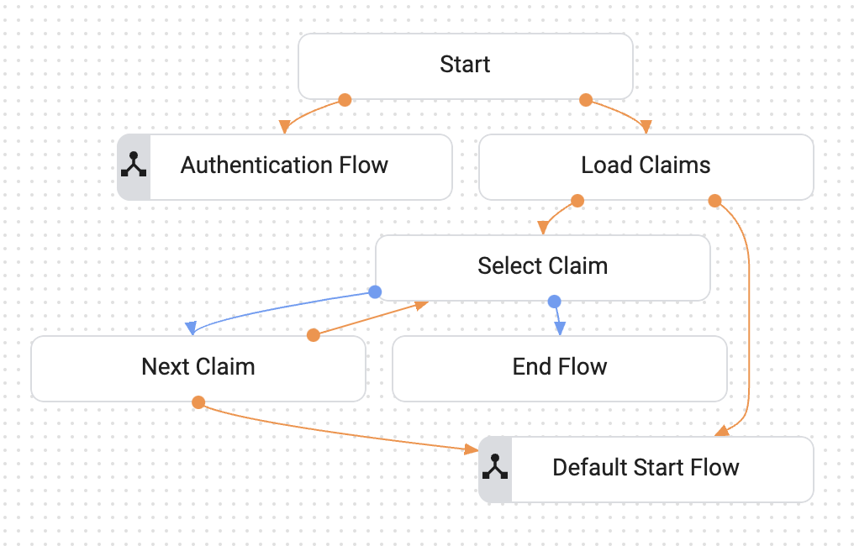
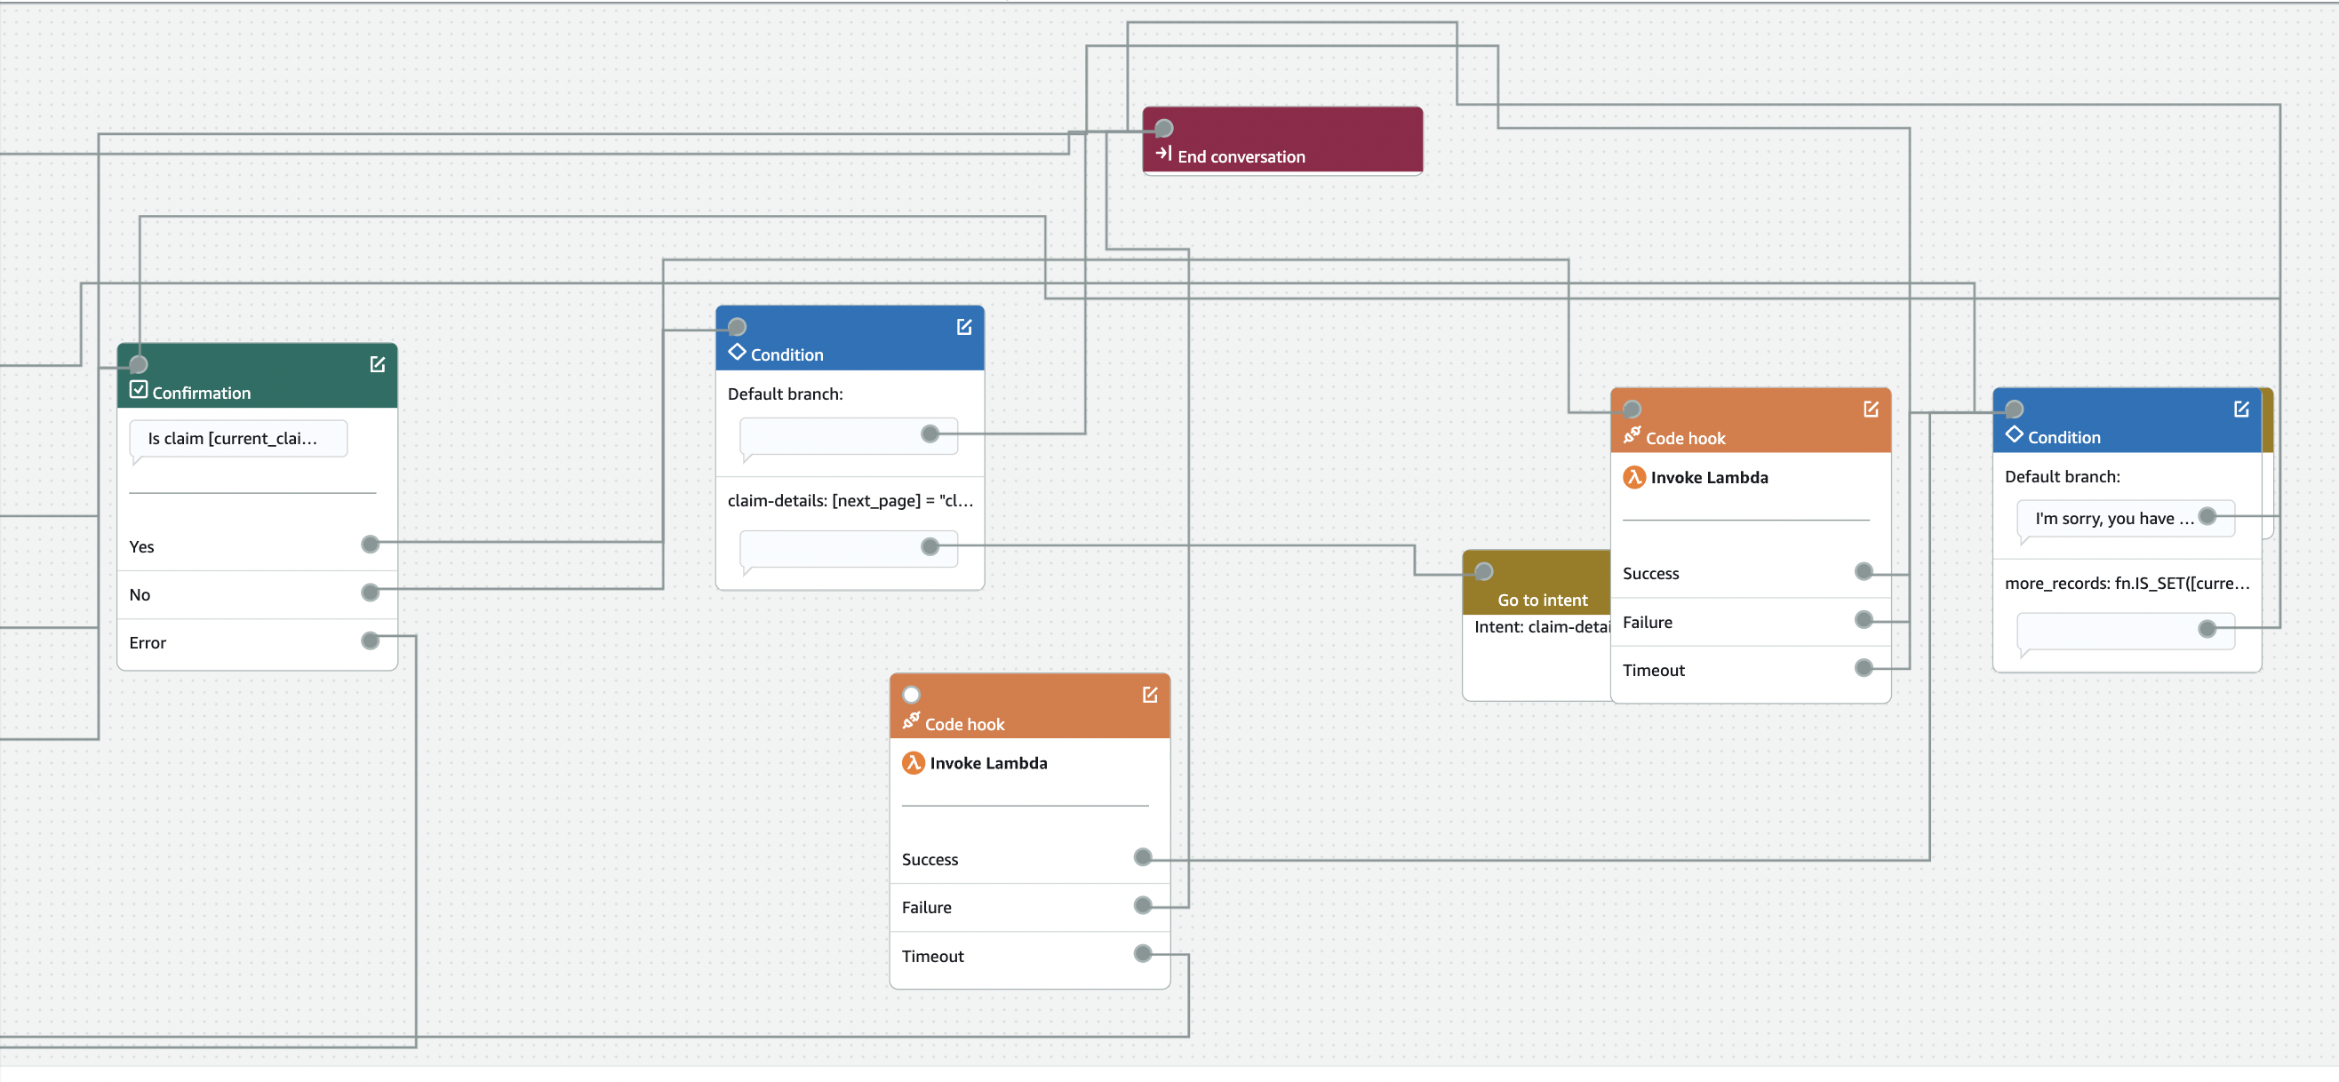
Can you guess which is which?

Slide 9

Build Time
DialogFlow
Builds are not required for each change of the flows.
As flows change, adding intents or pages, the NLU is updated in the background
The background learning doesn’t appear to take long either.
Lex
Build is required for every change
The learning appears to be getting slower the more Intents we add.

Slide 10
Route Organization
DialogFlow
Visual Builder is much more appealing
Route Groups allow for re-use
Flows can call other flows
Flows can contain multiple intent layers
Pages can link to any other page within flows and even to other start pages in other flows.
Lex
Visual Builder is confusing
Lines can overlap making it difficult to find connecting points
Some blocks (confirmation, closing remarks) can only be used once per intent
Some blocks (conditionals) cannot have multiple things leading to it

Slide 11
Intents
DialogFlow
Intents are handled at the page level
Can have multiple intent checks per flow
Means intents can be more directed within one flow
Lex
All Intents live at the root level
Within an Intent (or flow), it is impossible to have multiple other intents
An intent is a much smaller component

Slide 12
Environment Setup
DialogFlow
Requires DialogFlow API to be setup
Create DialogFlow Project
Create DialogFlow Agent within the Project
Agent must be in the Global environment to get a phone number (not sure about plugging into IVR)
Lex
Requires IAM permissions “lex:*”
Requires Lambda creation/running permissions
Requires role for uploading logs to CloudWatch for both Lex and Lambda
Create bot in the Lex UI

Slide 13
Testing Capabilities
DialogFlow
Comes with native testing capabilities
Can walk through a test scenario and then “save” the test to be run again
Can also have environments run tests daily or on deployment
Lex
We have not found any way to save test scenarios

Slide 14
Logging
DialogFlow
Visual Logging is great
Sometimes misses statements that the bot says
Sometimes misses statements the user says
Lex
CloudWatch is an industry standard with lots of query capabilities
Can also archive logs from CloudWatch into tools such as RedShift to be able to search longer term.

Slide 15
Debugging
DialogFlow
Tracks all parameters during test session
Tracks each flow and page within the flow during test session
Can step through each decision
Lex
Tracks slots during test session
Can see what intent you are on
Cannot see sessionAttributes
Cannot see what step you are on in the intent

Slide 16
Analytics
DialogFlow
Great analytics with lots of statistics
Abandon rates are tracked
Path choices are tracked
Unhandled messages are tracked
All shown in a graphical representation of a tree
Analytics are also exportable for database storage
Lex
We have not seen any analytics

Slide 17
Major Issues in DialogFlow
Utterances aren't always captured in logs – an anomaly we can't control for or expect
Toggling partial response "on" doesn't always provide the same outcome as expected.
Claim numbers must be manually overridden, the voice to text reads them as large numbers, not single digits.

Slide 18
Major Issues in Lex
We had issues where blocks inside of an intent would be duplicated without us duplicating them
Sometimes with the duplication, they wouldn’t show up until a refresh of the page
Properties would also change without our knowledge
Changed properties sometimes wouldn’t show up until a refresh of the page as well
V2 doesn't feel "Enterprise Ready"

